Slide 1
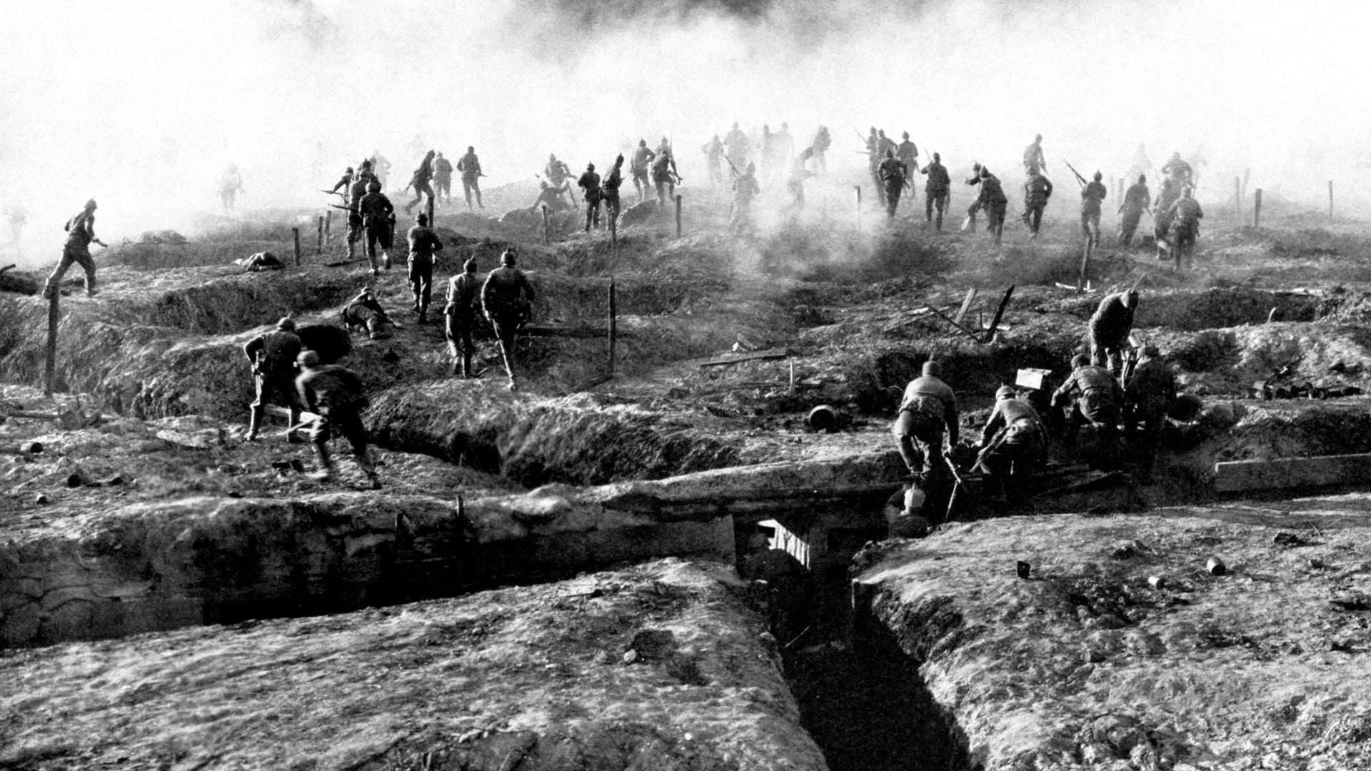
World War I
"A World Changed Forever: The Story of World War I"

Slide 2
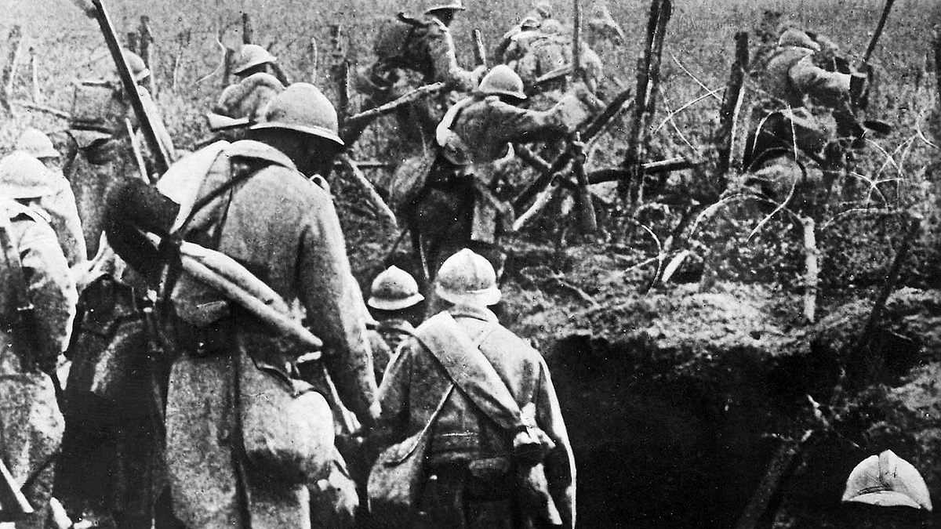
Slide 1: Introduction
Topic: World War I
Time Period: 1914-1918
Why It’s Important:
It was one of the biggest wars in history.
It changed the world and many countries’ futures.

Slide 3
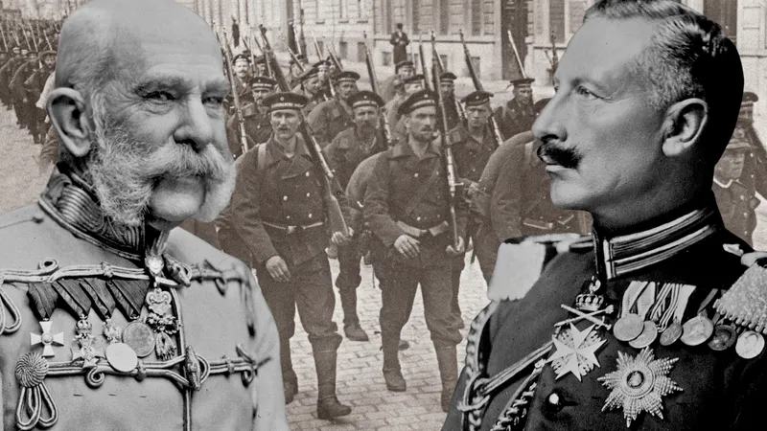
Slide 2: What Was World War I?
A war between two groups of countries:
Allied Powers: Britain, France, Russia, and later the USA.
Central Powers: Germany, Austria-Hungary, Ottoman Empire, and Bulgaria.
It started because of tensions in Europe and the assassination of Archduke Franz Ferdinand.

Slide 4
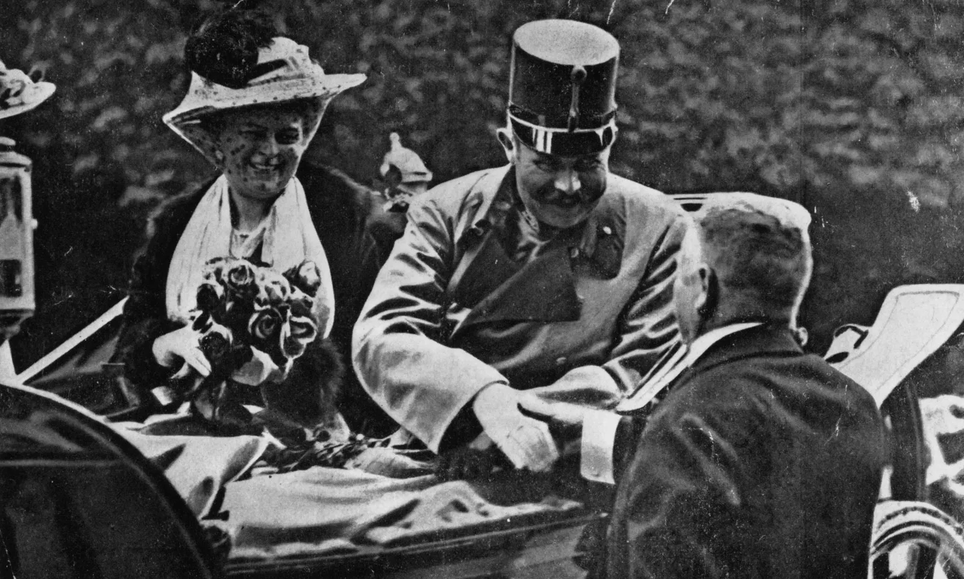
Slide 3: Main Events
1914: The assassination of Archduke Franz Ferdinand triggered alliances, and countries quickly joined the war.
Germany invaded Belgium to attack France.
The Ottoman Empire joined the Central Powers, opening new fronts in the Middle East and the Balkans.
1915: The Gallipoli Campaign became one of the key battles.
Mustafa Kemal Atatürk’s leadership at Gallipoli inspired his soldiers and became a turning point in the campaign.
1917: The USA joined the Allied Powers after German submarine attacks on their ships.
1918: The war ended with the surrender of Germany and its allies on November 11.

Slide 5
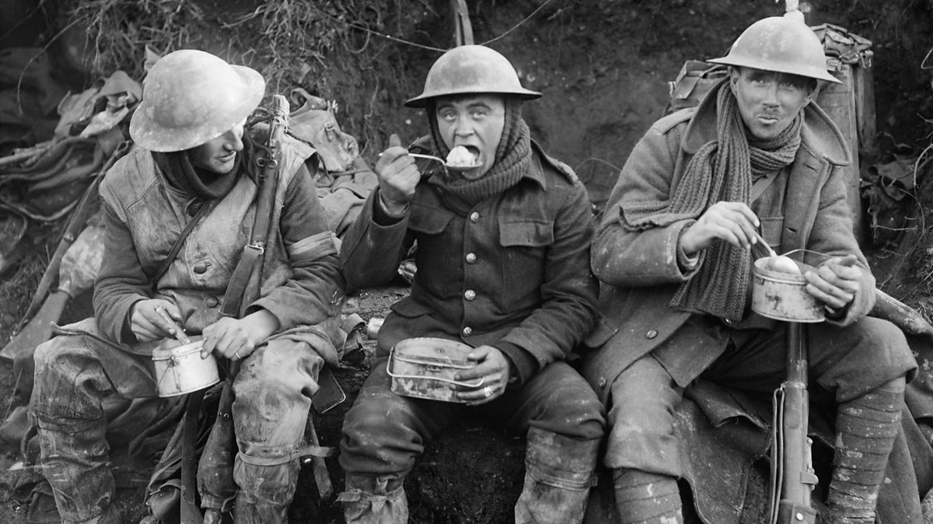
Slide 4: Life During the War
Soldiers:
Soldiers from all countries lived in trenches, facing harsh conditions like cold, disease, and hunger.
Ottoman soldiers at Gallipoli, under Mustafa Kemal’s command, showed incredible determination despite limited resources.
Civilians:
In Britain, France, and the USA, women worked in factories to produce weapons.
In the Ottoman Empire and Austria-Hungary, civilians faced food shortages and economic hardships due to blockades and resource demands.

Slide 6
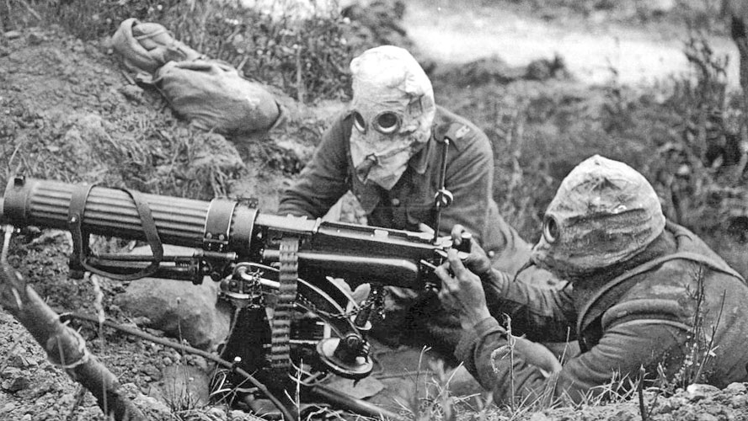
Slide 5: Weapons and Technology
Tanks and machine guns revolutionized ground battles, giving the advantage to defensive positions.
Poison gas caused immense suffering, particularly on the Western Front.
Strategic locations like the Dardanelles and industrial powerhouses like Germany’s Ruhr Valley showed the importance of geography and resources in war.

Slide 7
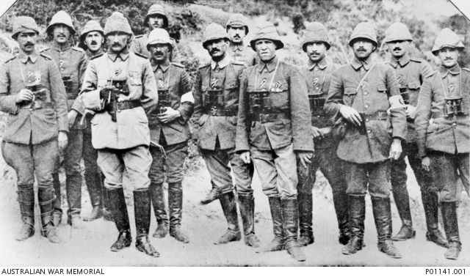
Slide 6: Key Figures
Mustafa Kemal Atatürk (Ottoman Empire):
Led the Ottoman forces at Gallipoli with exceptional strategy and courage.
His leadership inspired soldiers to defend their homeland and prevented the Allied Powers from advancing.
Atatürk’s success at Gallipoli marked him as a future leader, shaping Turkey’s modern history.
Winston Churchill (Britain):
Planned the Gallipoli Campaign, but his strategy failed, leading to heavy losses for the Allies.
Paul von Hindenburg (Germany):
Achieved victories on the Eastern Front against Russia.
Woodrow Wilson (USA):
Played a major role in peace efforts and proposed the League of Nations.

Slide 8
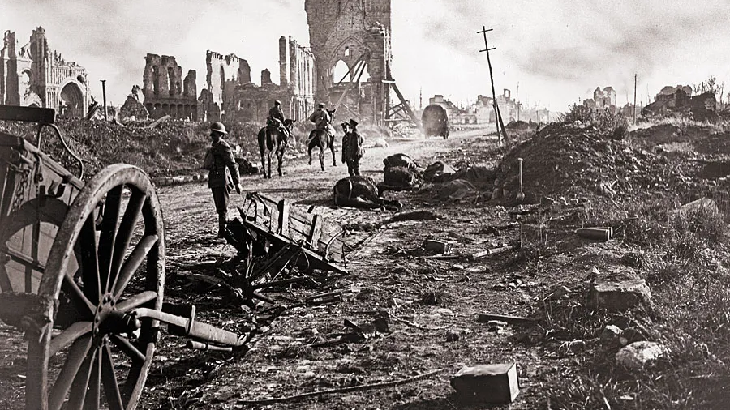
Slide 7: Effects of the War
Global Impact:
Over 16 million people died, with millions more wounded or displaced.
The Treaty of Versailles and other agreements reshaped Europe and the Middle East.
Political Changes:
Austria-Hungary and the Ottoman Empire dissolved, leading to the creation of new nations like Turkey, Yugoslavia, and Czechoslovakia.
Germany faced harsh reparations, leading to economic troubles and political unrest.

Slide 9
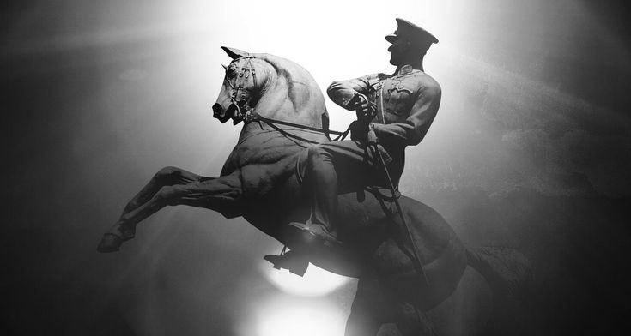
Slide 8: Why I Chose This Topic
World War I is fascinating because it shows how alliances, strategy, and leadership shaped the world.
I admire the leadership of figures like Mustafa Kemal Atatürk, who turned impossible situations into victories.
This topic teaches us about resilience and the importance of learning from history.

Slide 10
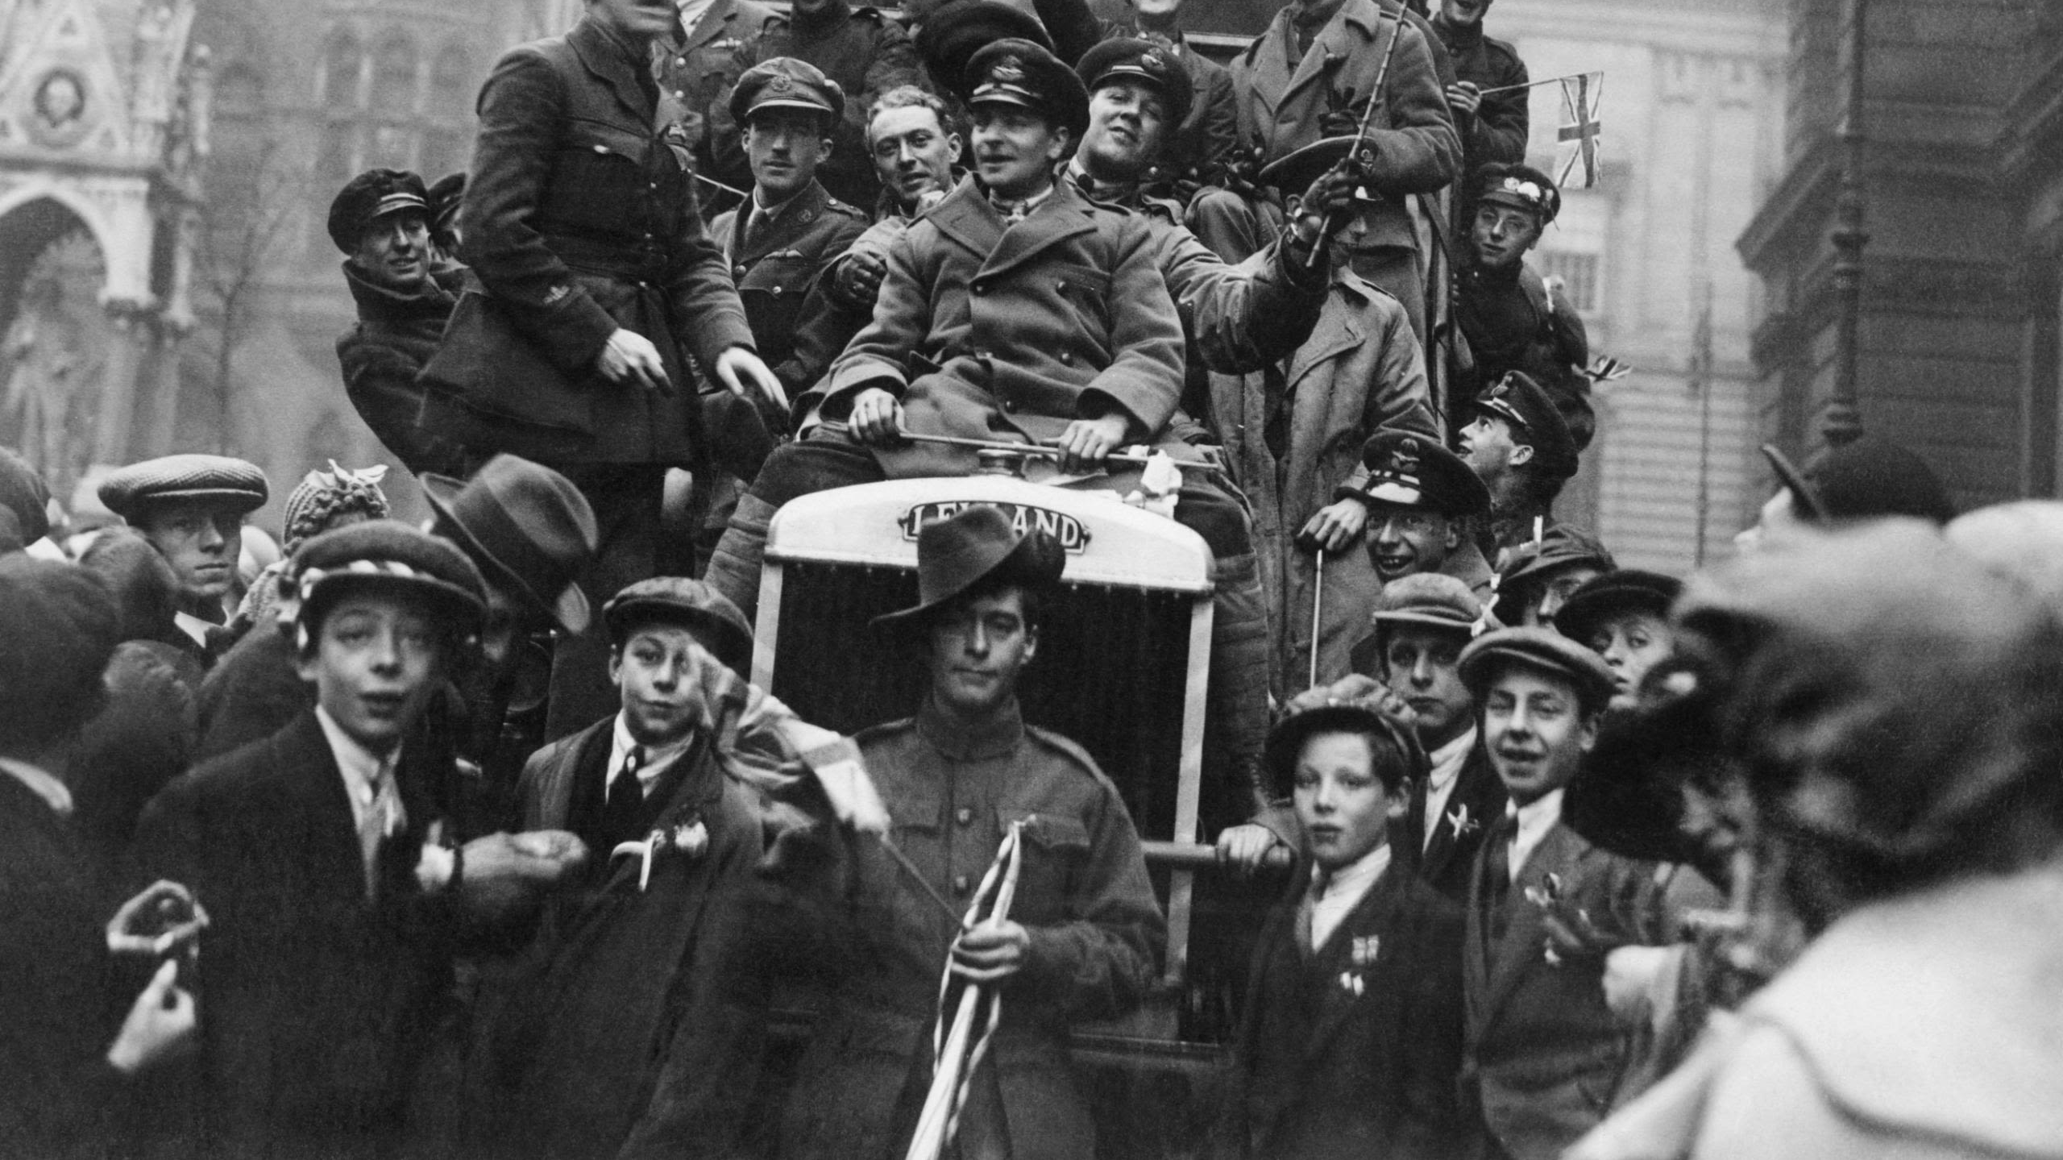
Slide 9: Conclusion
World War I was a tragic but transformative event that shaped the modern world.
Mustafa Kemal Atatürk’s leadership at Gallipoli stands out as an example of vision, bravery, and strategy during a time of great difficulty. “I am not ordering you to attack; I am ordering you to die,” he says.
The war reminds us of the courage and sacrifices of soldiers and civilians from all nations.

Slide 11
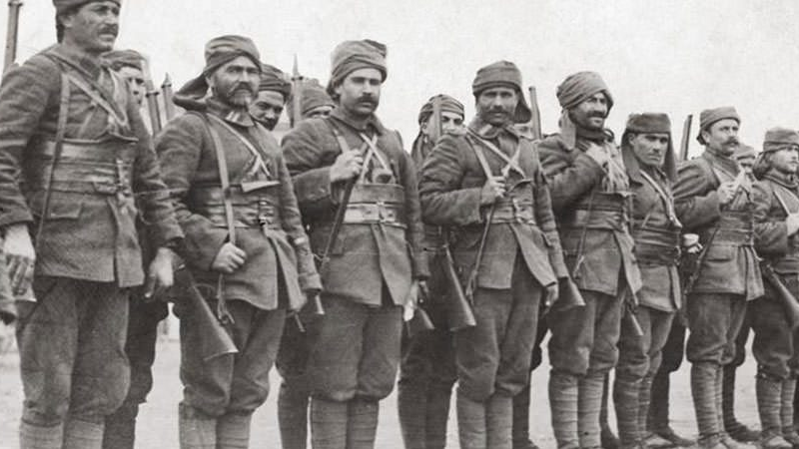
Thank you for listening to me.

